Slide 1
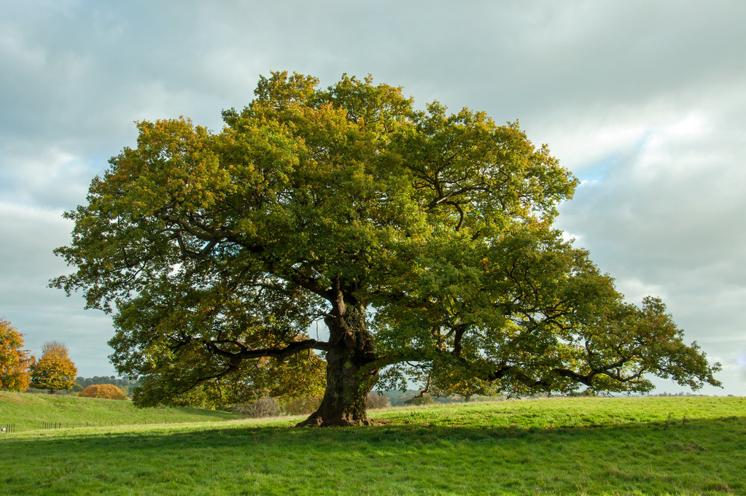
My Favorite Parks
By David Parks

Slide 2
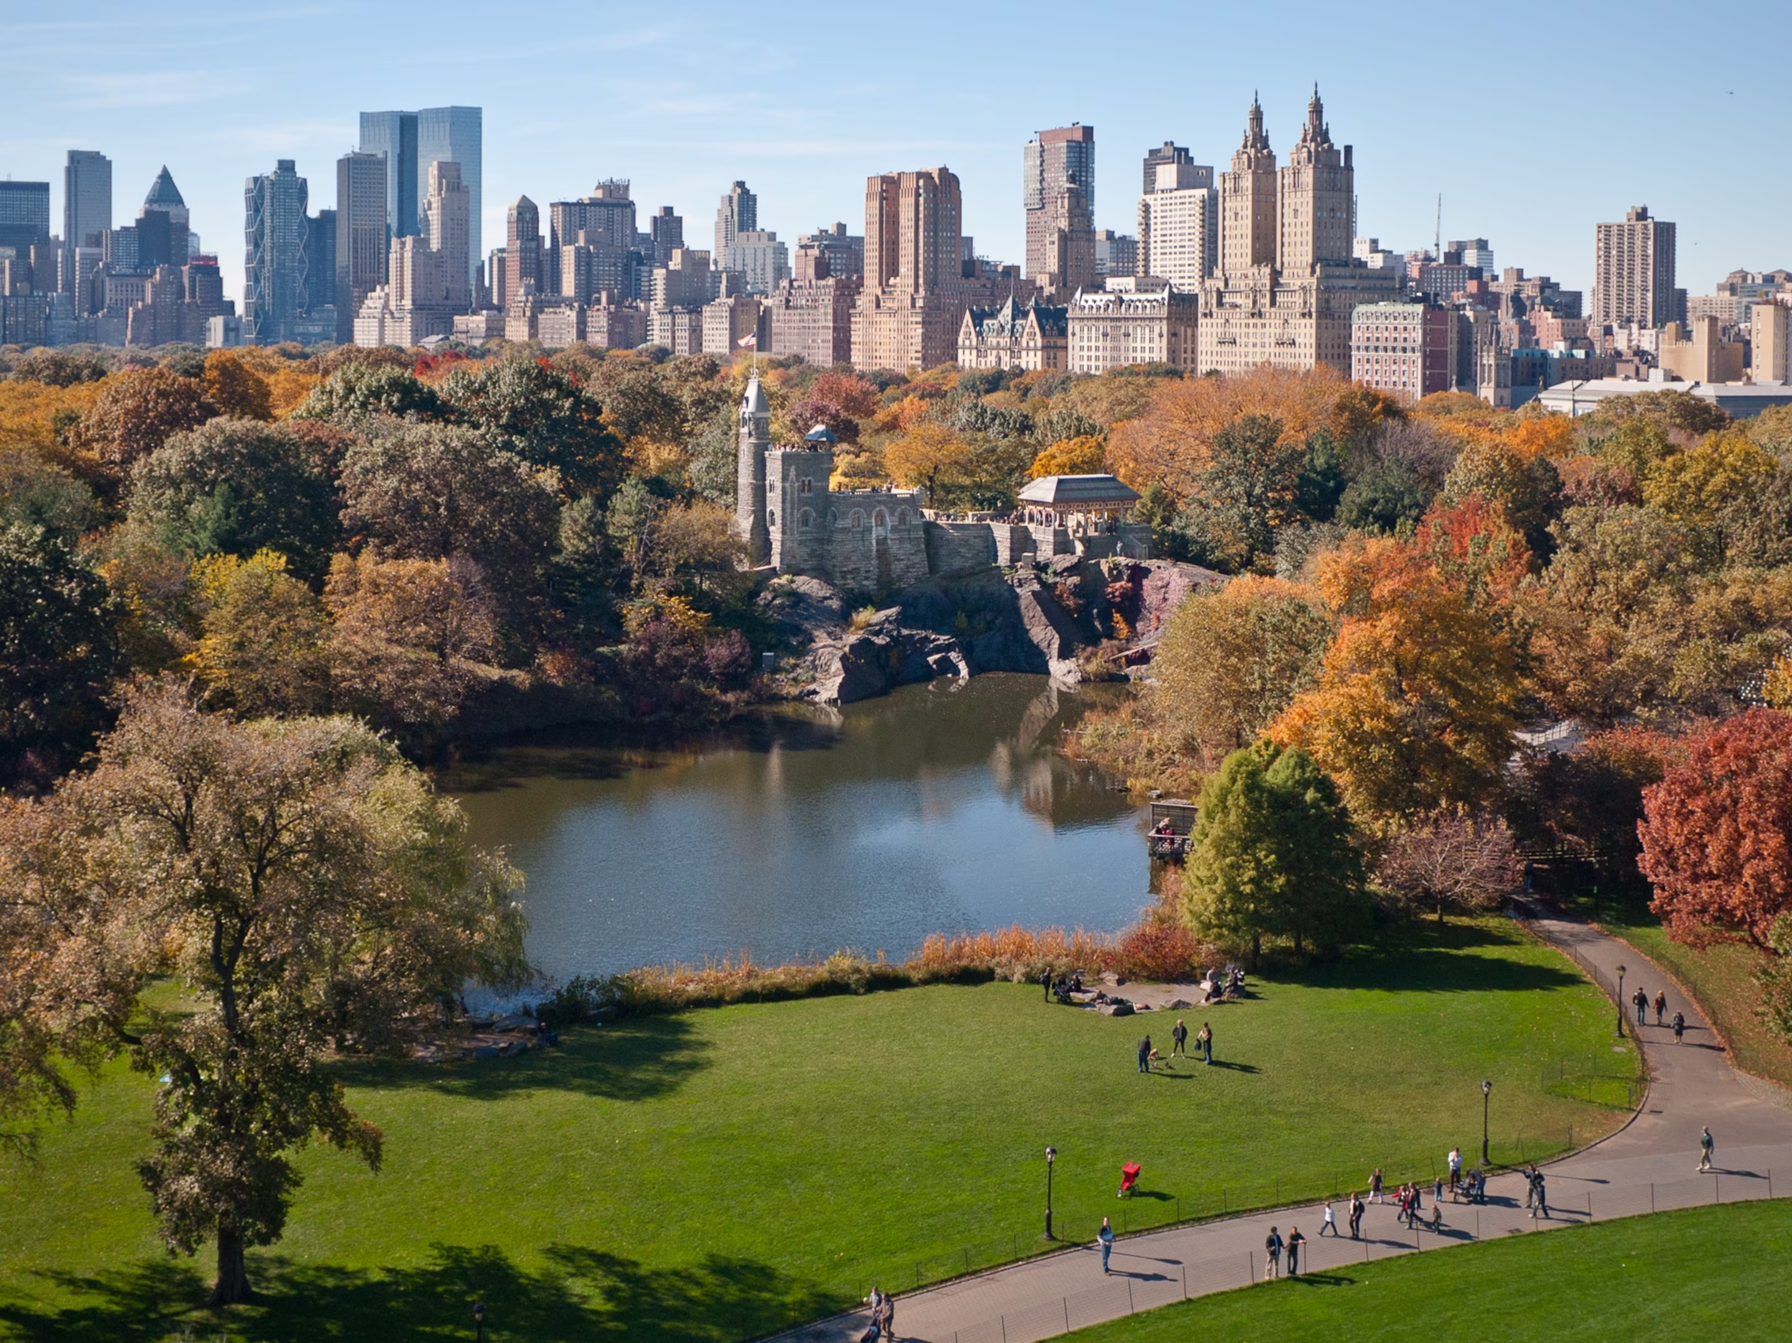
Central Park

Slide 3
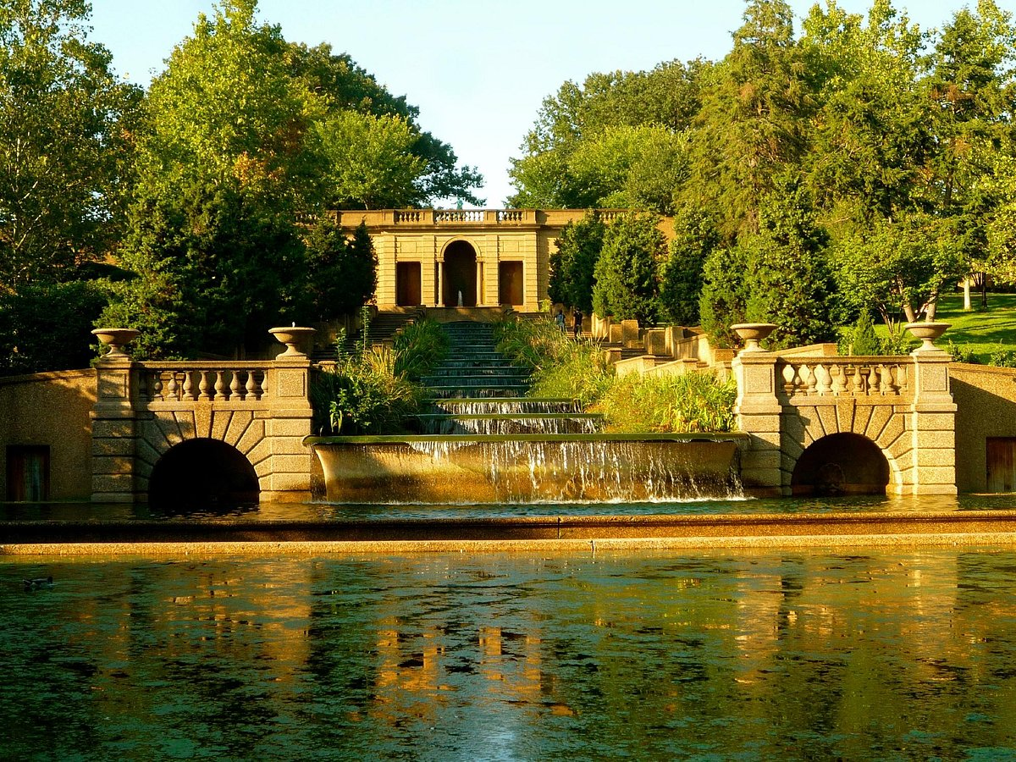
Meridian Hill Park

Slide 4
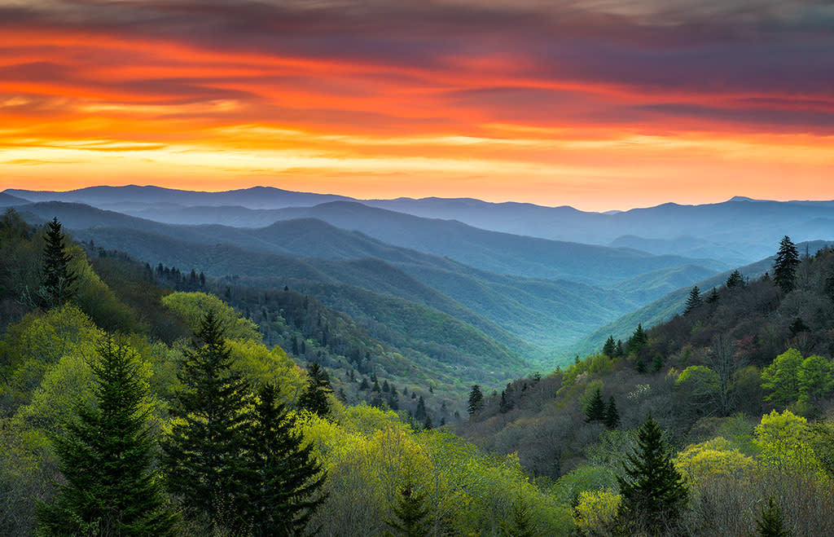
Great Smoky Mountains National Park

